Slide 1

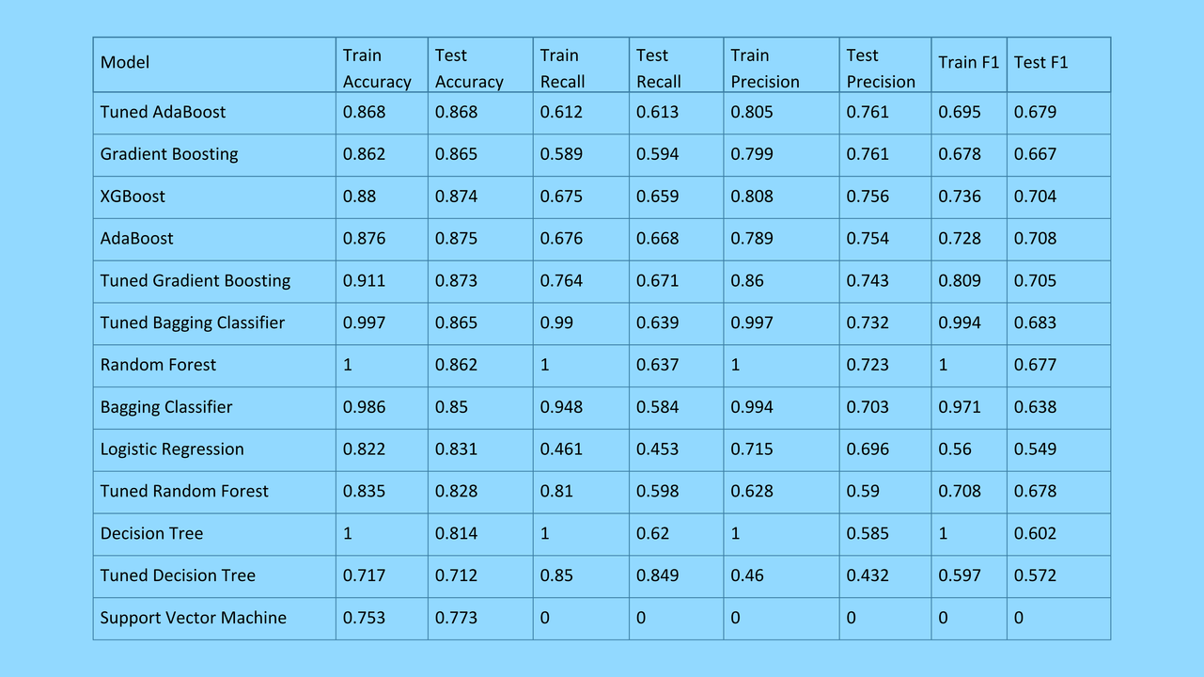
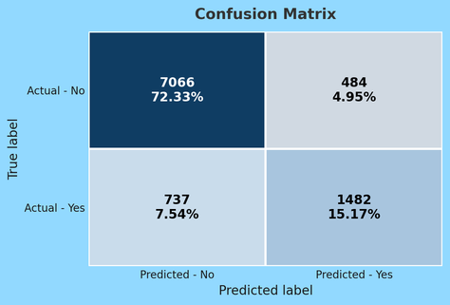

Predicting Income Using Census Data​
Tanuj Ranjith​
​
​
​
Introduction​
In this project, machine learning was utilized to predict whether an individual makes more than $50,000 annually; this determination is based on census and demographic data. Accurately predicting income can have applications in economics, social research, and targeted public services.
Evaluation Metrics
Accuracy: % of correctly classified examples
Recall: Focused on minimizing false negatives
Precision
F1 Score: Evaluated for balance between recall and Precision
Conclusion
Education level, capital gain, and hours-per-week were strong predictors of income
Ensemble methods outperformed single estimators
Skipping SVM allowed more time to tune tree-based models
Future work could improve recall and interpretability
Discussion
Education, capital gain, and hours-per-week were top predictors.
Tuned AdaBoost and Gradient Boosting performed best.
Focused on precision to reduce false positives.
Learned to manage class imbalance and compare models.
Data Analysis / Results
Feature distributions were analyzed to identify skew and imbalance
Key transformations were done for model compatibility
Label encoding helped convert strings to usable inputs
Visualizations of correlations and feature importances supported model selection
Tuned AdaBoost achieved the most precision
Dataset Description​
Rows: 48,842​
Columns:14
Target Variable: Income > 50K or <= 50k​
Key Independent Variables : age, education, occupation, marital-status, race, sex, hours-per-week, capital-gain, capital-loss, native-country
Some categorical values were label-encoded, and whitespaces were stripped for consistency.​
Methods
Data cleaning
Removed inconsistentformatting​
Label encoded categorical features besides income
Data splitting
70% training, 30% testing
Algorithms & Ensemble Methods
Decision Tree​, Tuned Decision Tree​, Bagging Classifier​, Tuned Bagging Classifier​, Random Forest​, Tuned Random Forest​, SVM
Tuned ADABoost
References
Scikit-learn Documentation
(https://scikit-learn.org/stable/modules/generated/sklearn.tree.DecisionTreeClassifier.html)

